Slide 1
L5 Planning
Z. Gu 2021

Slide 2
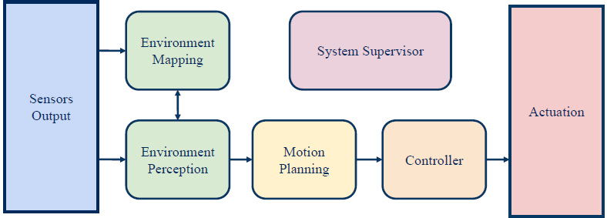
Planning

Slide 3
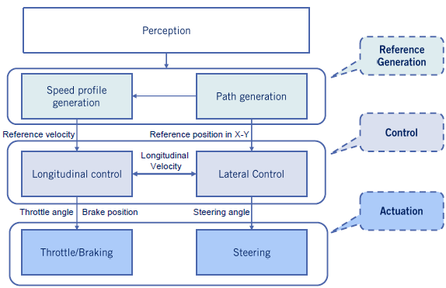
Vehicle Control Architecture

Slide 4
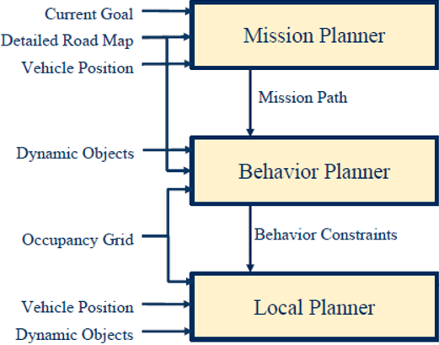
A Hierarchy of Planners
Mission Planning: map-level navigation
Behavior Planning: choosing a behavior based on environmental conditions
Local Planning: includes path planning and speed profile generation, generates a reference trajectory to be tracked by controller
Reference Trajectory
Controller (PID, MPC…)

Slide 5
Route Planning: map-level navigation
Behavior Planning: choosing a behavior based on environmental conditions
Local Planning: includes path planning and speed profile generation, generates a reference trajectory to be tracked by controller

Slide 6
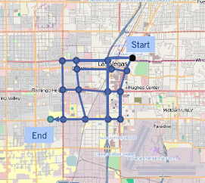
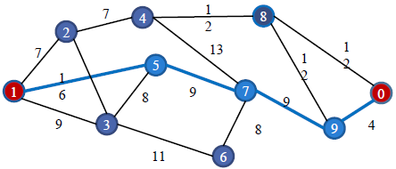
Route Planning
Find the optimal path for navigation from Start to Goal on a weighted graph.
Notes:
Use graph search to find a high-level path from source to destination on the map

Slide 7
Mission Planning Methods
Also called Route Planning.
Graph search algorithms
Dijkstra’s, A*,…

Slide 8
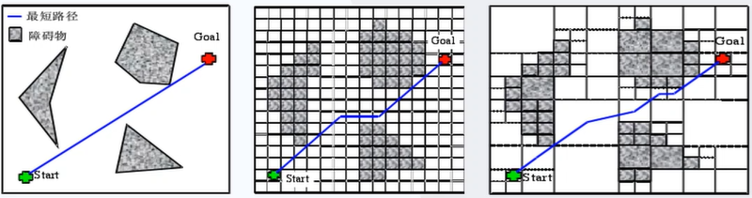
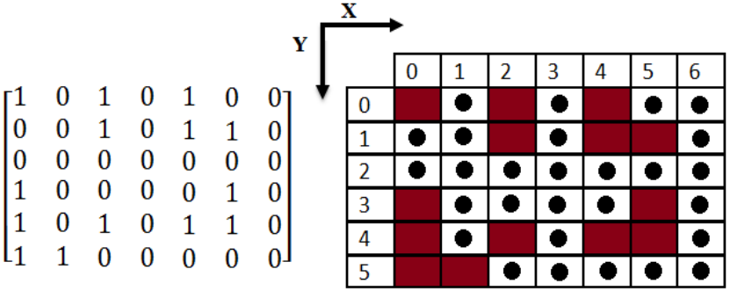
Map Representations
Geometry-based or occupancy grid-based
Matrix encoding of an occupancy grid map

Slide 9
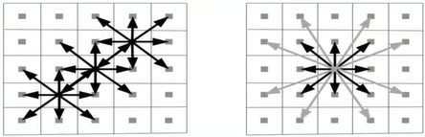
Graph Construction
A graph can be constructed
Based on connectivity, e.g., 4, 8 (left) or 16 (right), of an occupancy grid, mainly for mobile robots
Based on road network with traffic rules
An edge may be undirected for a two-way road, or directed for a one-way road.

Slide 10
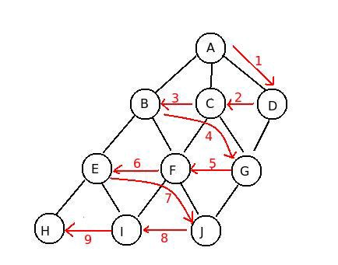
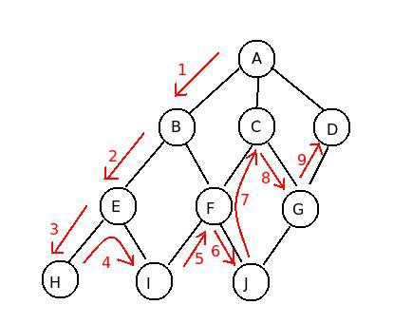
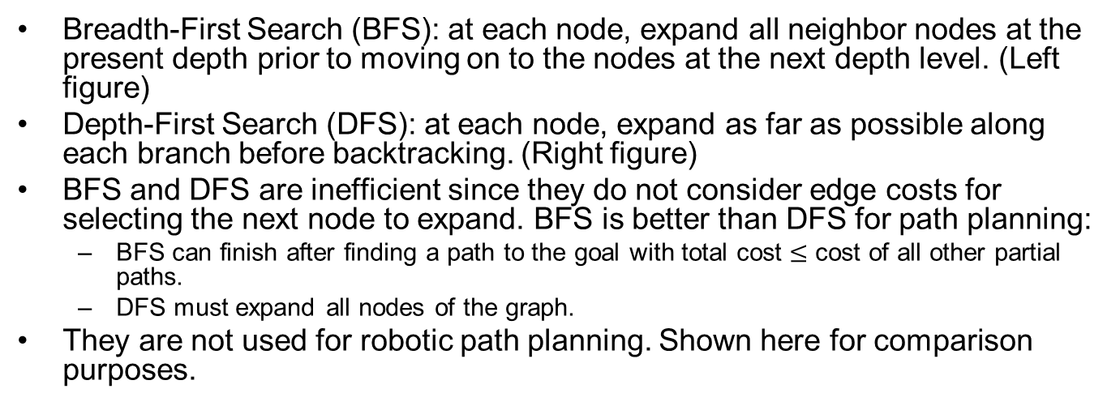
BFS and DFS
Breadth-First Search (BFS): at each node, expand all neighbor nodes at the present depth prior to moving on to the nodes at the next depth level. (Left figure)
Depth-First Search (DFS): at each node, expand as far as possible along each branch before backtracking. (Right figure)
BFS and DFS are inefficient since they do not consider edge costs for selecting the next node to expand. BFS is better than DFS for path planning:
BFS can finish after finding a path to the goal with total cost $≤$ cost of all other partial paths.
DFS must expand all nodes of the graph.
They are not used for robotic path planning. Shown here for comparison purposes.
https://medium.com/@nihatkoc/dfs-vs-bfs-6b632c381ed6
Notes:
We will discuss Dijkstra’s and A* algorithm:
Both can finish after finding a path to goal, and the path is

Slide 11
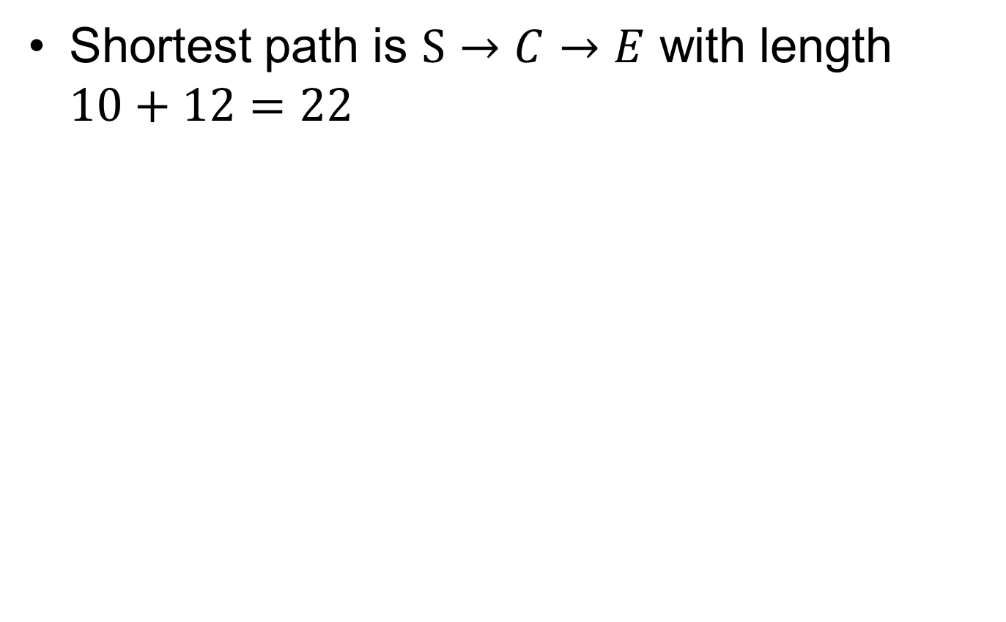
Running Example
Shortest path is $S→C→E$ with length $10+12=22$
S
2
A
3
B
10
20
C
12
G

Slide 12
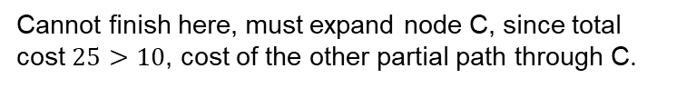
BFS
S
2
A
3
B
S
2
A
3
B
10
20
10
20
C
12
G
C
12
G
S
2
A
3
B
S
2
A
3
B
10
20
10
20
C
12
G
C
12
G
S
2
A
3
B
S
2
A
3
B
10
20
10
20
C
12
G
C
12
G
Cannot finish here, must expand node C, since total cost $25>10$, cost of the other partial path through C.
Notes:
(Cannot finish here, must expand node B
since B’s cost to S 5 is less than 22.)

Slide 13
DFS
S
2
A
3
B
S
2
A
3
B
10
20
10
20
C
12
G
C
12
G
S
2
A
3
B
S
2
A
3
B
10
20
10
20
C
12
G
C
12
G
S
2
A
3
B
S
2
A
3
B
10
20
10
20
C
12
G
C
12
G
Must always expand all nodes.

Slide 14
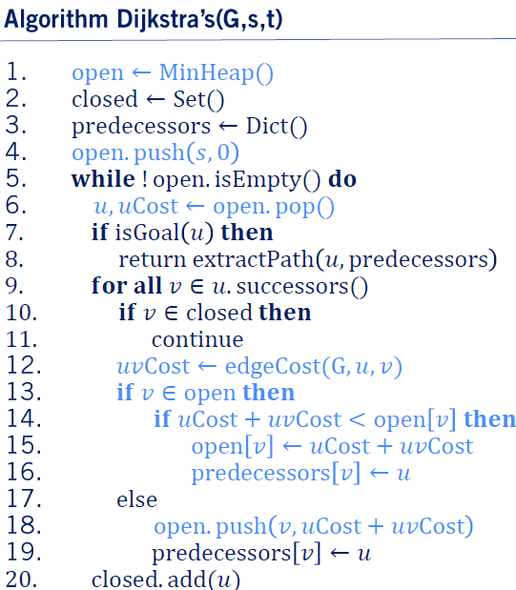
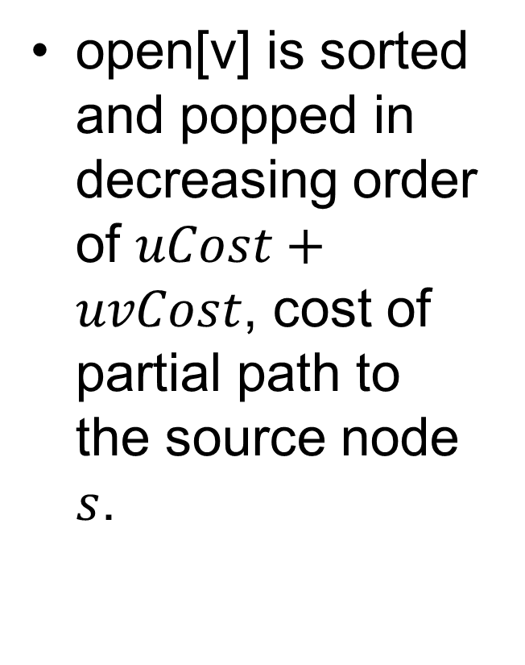
Dijkstra’s Algorithm
open[v] is sorted and popped in decreasing order of $uCost+uvCost$, cost of partial path to the source node $s$.

Slide 15
Dijkstra Example
S
2
A
3
B
Node | Cost to S
S | 0
10
20
C
12
G
Node | Cost to S
A | 2
C | 10
S
A
B
2
3
10
20
Closed set: S
C
12
G
Node | Cost to S
B | 5
C | 10
S
2
A
3
B
10
20
C
12
G
Closed set: S, A

Slide 16
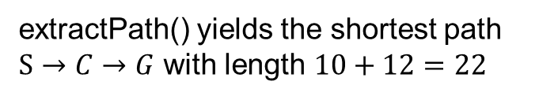
Dijkstra Example cont’
S
2
A
3
B
Node | Cost to S
C | 10
G | 25
10
20
C
12
G
Closed set: S, A, B
Node | Cost to S
G | 22
S
2
A
3
B
10
20
Closed set: S, A, B, C
C
12
G
S
2
A
3
B
extractPath() yields the shortest path $S→C→G$ with length $10+12=22$
10
20
C
12
G

Slide 17
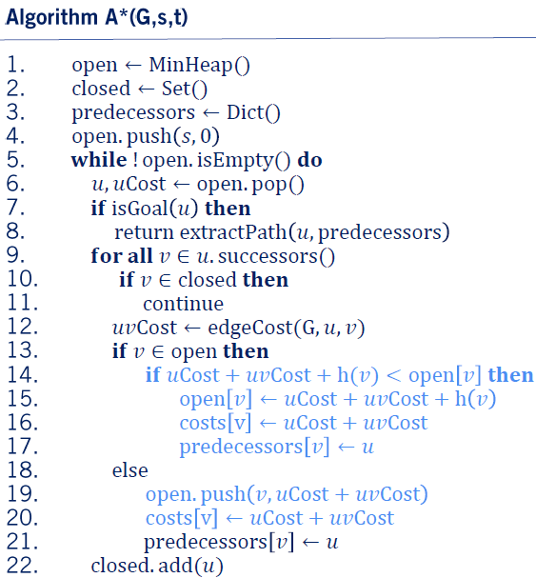
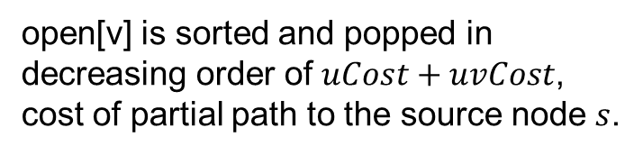
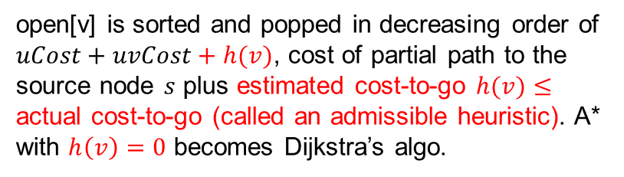
A* Algorithm (Compare to Dijkstra)
open[v] is sorted and popped in decreasing order of $uCost+uvCost+h(v)$, cost of partial path to the source node $s$ plus estimated cost-to-go $h(v)≤$ actual cost-to-go (called an admissible heuristic). A* with $h\left(v\right)=0$ becomes Dijkstra’s algo.
open[v] is sorted and popped in decreasing order of $uCost+uvCost$, cost of partial path to the source node $s$.

Slide 18
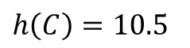
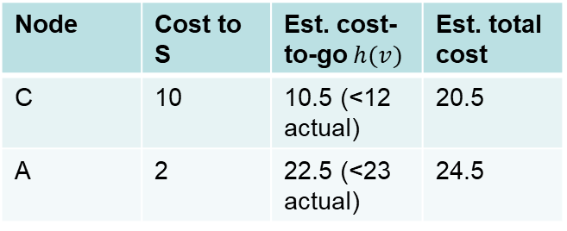
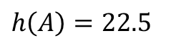
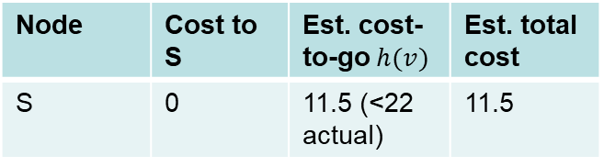
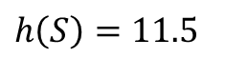
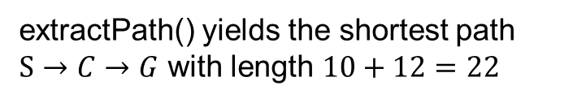
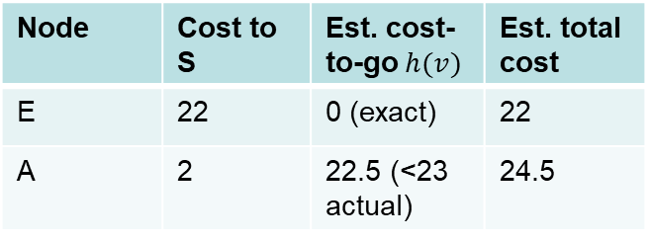
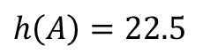
A* Example
S
2
A
3
B
Node | Cost to S | Est. cost-to-go $h(v)$ | Est. total cost
S | 0 | 11.5 (<22 actual) | 11.5
$h\left(S\right)=11.5$
10
20
C
12
G
$h\left(A\right)=22.5$
Node | Cost to S | Est. cost-to-go $h(v)$ | Est. total cost
C | 10 | 10.5 (<12 actual) | 20.5
A | 2 | 22.5 (<23 actual) | 24.5
S
2
A
3
B
10
20
$h\left(C\right)=10.5$
C
12
G
Closed set: S
Closed set: S
$h\left(A\right)=22.5$
Node | Cost to S | Est. cost-to-go $h(v)$ | Est. total cost
E | 22 | 0 (exact) | 22
A | 2 | 22.5 (<23 actual) | 24.5
S
2
A
3
B
10
20
C
12
G
Closed set: S, C
extractPath() yields the shortest path $S→C→G$ with length $10+12=22$

Slide 19
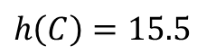
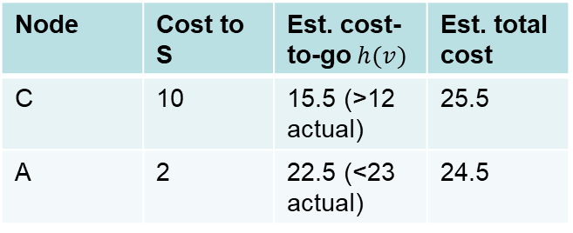
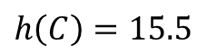
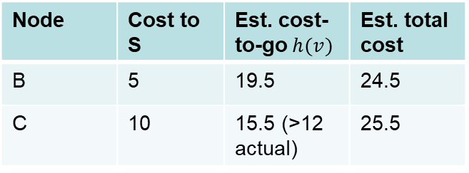
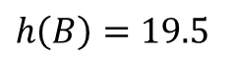
A* Example w Inadmissible Heuristic
S
2
A
3
B
Node | Cost to S | Est. cost-to-go $h(v)$ | Est. total cost
S | 0 | 11.5 (<22 actual) | 11.5
$h\left(S\right)=11.5$
10
20
C
12
G
$h\left(A\right)=22.5$
Node | Cost to S | Est. cost-to-go $h(v)$ | Est. total cost
C | 10 | 15.5 (>12 actual) | 25.5
A | 2 | 22.5 (<23 actual) | 24.5
S
2
A
3
B
10
20
$h\left(C\right)=15.5$
C
12
G
Closed set: S
Closed set: S
$h\left(B\right)=19.5$
Node | Cost to S | Est. cost-to-go $h(v)$ | Est. total cost
B | 5 | 19.5 | 24.5
C | 10 | 15.5 (>12 actual) | 25.5
S
2
A
3
B
10
$h\left(C\right)=15.5$
20
C
12
G
Closed set: S, C

Slide 20
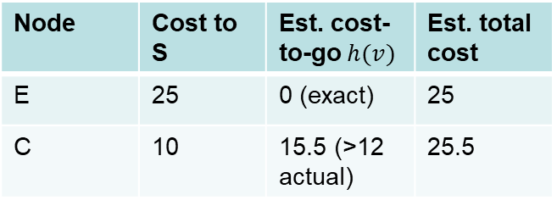
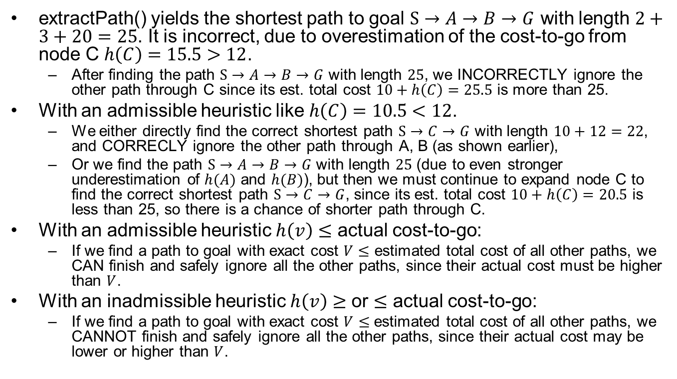
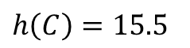
A* Example w Inadmissible Heuristic
Node | Cost to S | Est. cost-to-go $h(v)$ | Est. total cost
E | 25 | 0 (exact) | 25
C | 10 | 15.5 (>12 actual) | 25.5
S
2
A
3
B
10
$h\left(C\right)=15.5$
20
C
12
G
Closed set: S, A, B
extractPath() yields the shortest path to goal $S→A→B→G$ with length $2+3+20=25$. It is incorrect, due to overestimation of the cost-to-go from node C $h\left(C\right)=15.5>12$.
After finding the path $S→A→B→G$ with length $25$, we INCORRECTLY ignore the other path through C since its est. total cost $10+h\left(C\right)=25.5$ is more than 25.
With an admissible heuristic like $h\left(C\right)=10.5<12$.
We either directly find the correct shortest path $S→C→G$ with length $10+12=22$, and CORRECLY ignore the other path through A, B (as shown earlier),
Or we find the path $S→A→B→G$ with length $25$ (due to even stronger underestimation of $h(A)$ and $h(B)$), but then we must continue to expand node C to find the correct shortest path $S→C→G$, since its est. total cost $10+h\left(C\right)=20.5$ is less than 25, so there is a chance of shorter path through C.
With an admissible heuristic $h\left(v\right)≤$ actual cost-to-go:
If we find a path to goal with exact cost $V≤$ estimated total cost of all other paths, we CAN finish and safely ignore all the other paths, since their actual cost must be higher than $V$.
With an inadmissible heuristic $h\left(v\right)$ $≥$ or $≤$ actual cost-to-go:
If we find a path to goal with exact cost $V$ $≤$ estimated total cost of all other paths, we CANNOT finish and safely ignore all the other paths, since their actual cost may be lower or higher than $V$.
Notes:
extractPath() yields the shortest path $S→A→B→E$ with length $2+3+20=25$. It is incorrect, due to overestimation of the cost-to-go from node C $h\left(C\right)=15.5>12$. After finding the path $S→A→B→E$ with length $25$, we
With an admissible heuristic like $h\left(C\right)=10.5<12$.

Slide 21
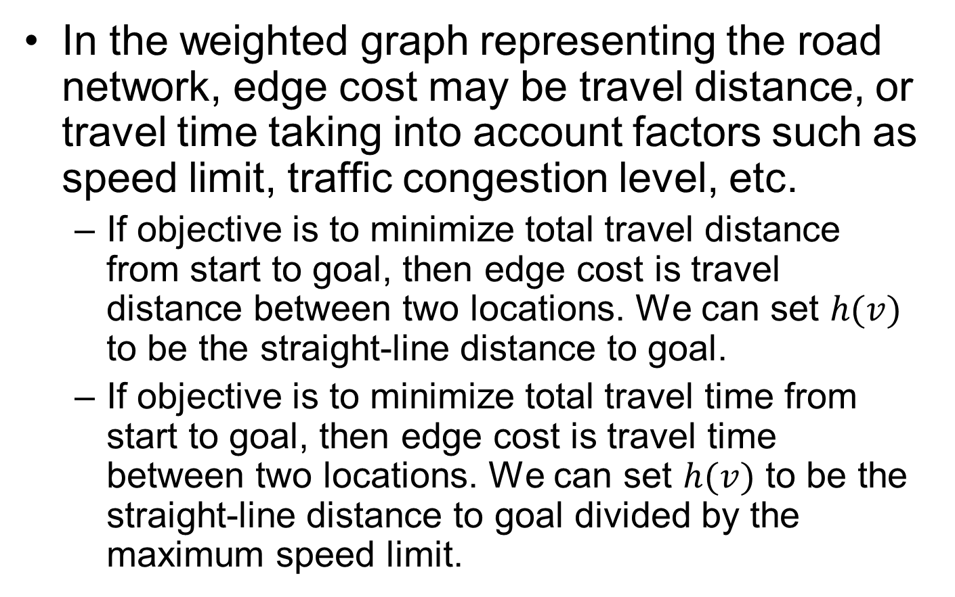
How to Design an Admissible Heuristic?
In the weighted graph representing the road network, edge cost may be travel distance, or travel time taking into account factors such as speed limit, traffic congestion level, etc.
If objective is to minimize total travel distance from start to goal, then edge cost is travel distance between two locations. We can set $h(v)$ to be the straight-line distance to goal.
If objective is to minimize total travel time from start to goal, then edge cost is travel time between two locations. We can set $h(v)$ to be the straight-line distance to goal divided by the maximum speed limit.

Slide 22
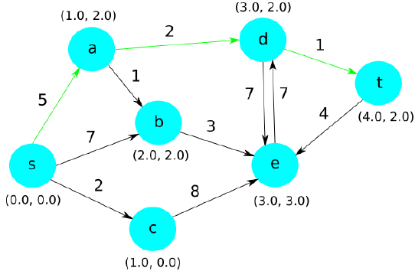
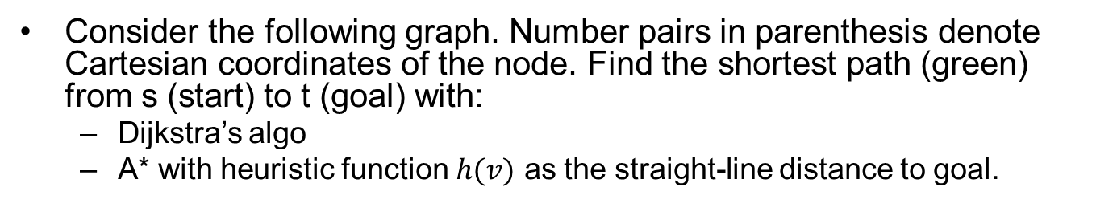
Exercise
Consider the following graph. Number pairs in parenthesis denote Cartesian coordinates of the node. Find the shortest path (green) from s (start) to t (goal) with:
Dijkstra’s algo
A* with heuristic function $h(v)$ as the straight-line distance to goal.

Slide 23
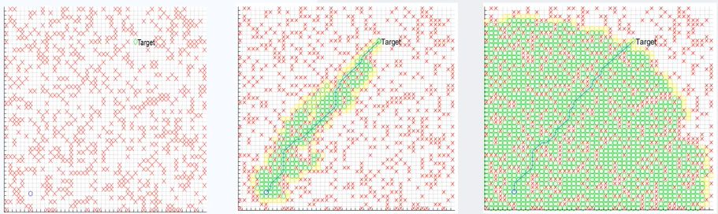
A* vs. Dijkstra
Red crosses denote obstacles.
Green circles denote explored positions.
A* search is more efficient, as it is directed towards the target; Dijkstra’s algorithm explores in every direction and less efficient.
Grid Map
A* Algorithm
Dijkstra’s Algorithm

Slide 24
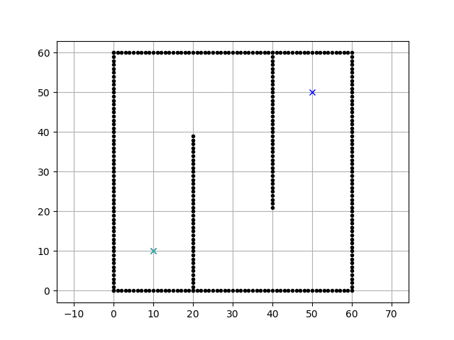

A* vs. Dijkstra (Animation)
Dijkstra
A*
More animations https://qiao.github.io/PathFinding.js/visual/
https://github.com/AtsushiSakai/PythonRobotics

Slide 25
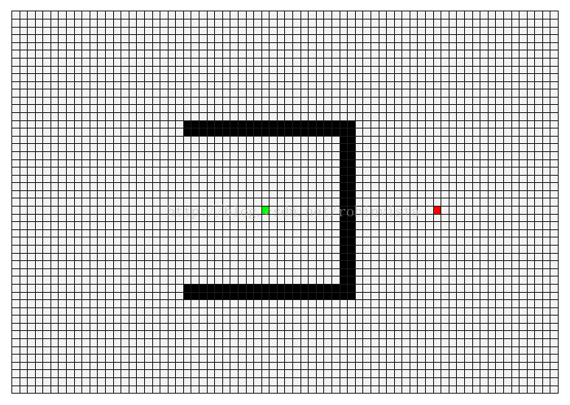

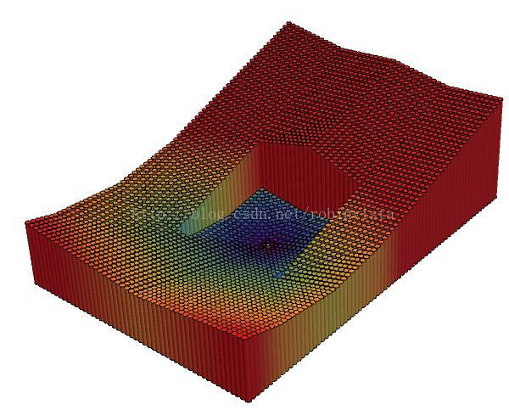
A* vs. Dijkstra (Another Animation)
Dijkstra’s Algorithm
A* Algorithm
Visualization of path length to starting location
https://blog.csdn.net/robinvista/article/details/53913613

Slide 26
Behavior Planner

Slide 27
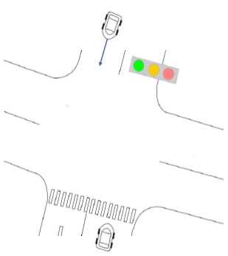
Behavior Planner
Plan the set of high-level driving actions, or maneuvers to safely achieve the driving mission under various driving situations based on:
Rules of the road (traffic lights, stop signs…)
Static objects (parked vehicles…)
Dynamic objects (moving vehicles, cyclists, pedestrians…). Need behavior prediction.

Slide 28
Driving Maneuvers
Track speed
Maintain current speed consistent with other vehicles on the road.
Follow leader
Match speed of the leading vehicle and maintain a safe distance.
Decelerate to stop
Begin decelerating and stop before a given space.
Stop
Remain in the current position.
Change lanes
Turn
Left, right, U-turn…
Pass
Complex maneuver involving changing lanes, passing, (optional) changing back to ego-lane.
Notes:
Choose a maneuver (stop, go straight, turn left, turn right..),

Slide 29
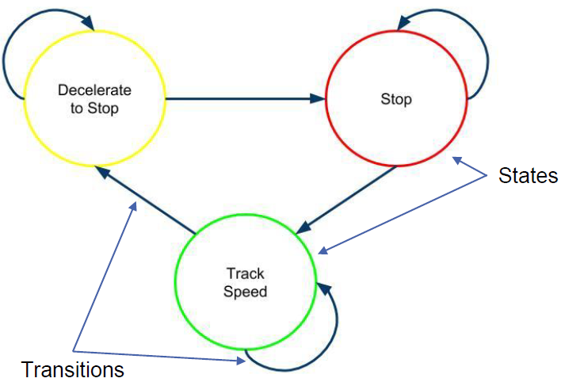
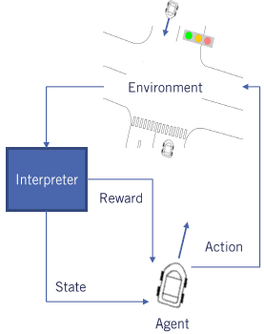
Behavior Planning Approaches
Finite State Machine-based
Transitions triggered by inputs, e.g., traffic light changing color.
Explicitly designed by experts
Reinforcement Learning-based
Learned from trial-and-error to maximize cumulative reward.

Slide 30
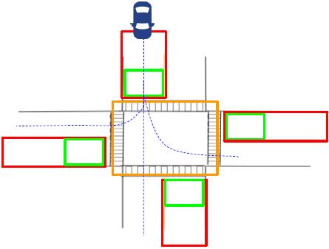
An Intersection Scenario without Dynamic Objects
4-way intersection
Two-lane road
Stop sign in every direction
No other dynamic objects
Discretized into
Approaching zone (red box)
At zone (green box)
On zone (orange box)
Size of each zone determined by
Ego vehicle speed
Size of the intersection

Slide 31
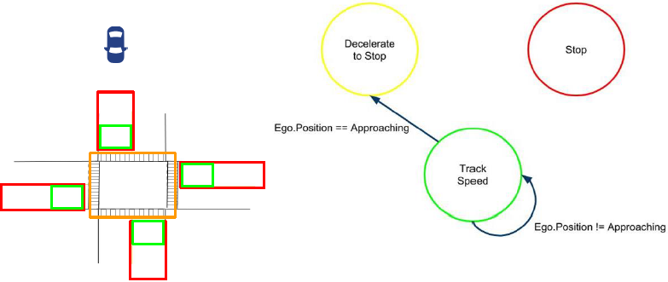
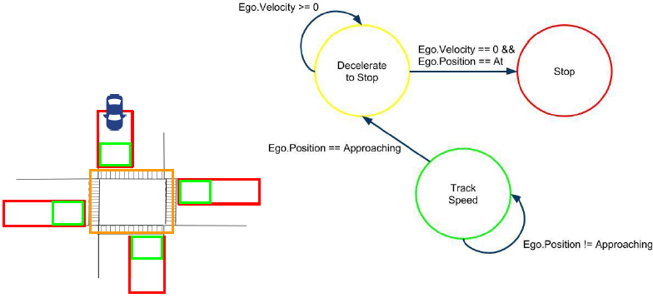
✔
✔
Notes:
(✔

Slide 32
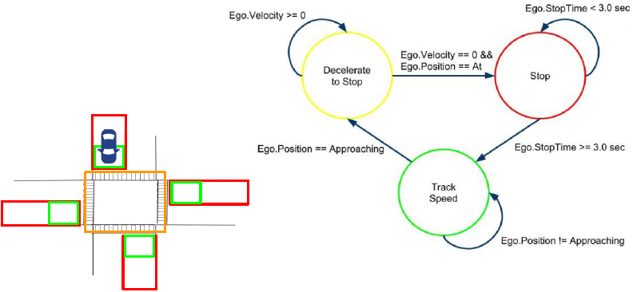
✔
To make the state machine more robust to noise in state estimation, may change Ego.Velocity==0 to Ego.Velocity<=StopThreshold
For an intersection with stop signs, there is no transition from “Decelerate to Stop” to “Track Speed”, since vehicle must come to a complete stop at a Stop sign
For an intersection with traffic lights, there should be such a transition, as the light may turn green while vehicle is decelerating.

Slide 33
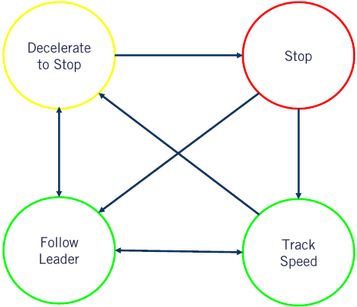
An Intersection Scenario with Dynamic Objects
Additional state “Follow Leader” to handle situation when another vehicle is in front of ego-vehicle.
Again, no transition from “Decelerate to Stop” to “Track Speed”, since vehicle must come to a complete stop at a Stop sign

Slide 34

Handling Multiple Scenarios
Each driving scenario is modeled as a super-state, which contains a low-level state machine for the scenario.

Slide 35
Local Planner

Slide 36

Local Planner
Generate a feasible (smooth and collision-free) trajectory
Decomposed into path planning and speed profile generation

Slide 37


Local Planning Methods
Also called trajectory planning, includes path planning and speed profile generation:
Path planning:
Graph search algorithms
Dijkstra’s, A*, Hybrid A*
Sampling-based algorithms
Rapidly-exploring Random Tree (RRT)
Probabilistic Roadmap (PRM)
Path planning for parking
Dubins and Reeds-Shepp curves
Generating smooth paths
Conformal Lattice Planning
Speed profile generation
Combined approaches
Artificial Potential Field (APF)
Dynamic Window Algorithm (DWA)
Optimal control, MPC (not discussed)
Notes:
Assign speed value to every point on a given path.

Slide 38
Limitations of A* and Dijkstra’s Algo for Local Planning
Both are discrete methods
They do not consider kinematic and dynamic constraints, e.g.,
Cannot move sideways directly (except some specialized vehicles).
Turning angle is limited within a range.
If the vehicle’s heading is north, and the path planner says “go right”, then the vehicle needs to make a long turning motion to go to the right grid.
Notes:
Only 8% of path planning points can be executed. Vehicle movement is based on the Bicycle kinematic model

Slide 39


Hybrid A*
Use predefined Motion Primitives to get reachable states and construct the search tree. The resulting path is smooth and kinematically feasible.
Motion Primitive: realizable translation and rotation in a time step under max acceleration and speed constraints, and:
Distance traveled is large enough to leave the current grid
Curvature is constrained by max turning angle
Orientation change is integer multiple of discrete turning angle step size
Used by Stanford in 2005 DARPA Grand Challenge.
Notes:
Combined path and trajectory planning

Slide 40

A* vs. Hybrid A*
 | A* | Hybrid A*
State Representation | Discrete location at grid $(x,y)$ | Continuous pose incl. heading angle $(x,y,θ)$
Search Expansion Strategy | Every neighbor grid is a search node (8 or 16 choices) | Predefined Motion Primitives: multiple search nodes may exist in the same grid
Completeness | Yes | No
Optimality | Yes | No

Slide 41
Quiz: Dijkstra’s, A*, Hybrid A*
Which of the following statements are true for Dijkstra’s algo, A*, Hybrid A*, respectively?
A. It is a continuous method.
B. It uses a heuristic function to guide node expansion.
C. It always finds a path if one exists.
D. The path it finds are guaranteed to be drivable.
E. The path it finds are guaranteed to be optimal (shortest).
ANS:
Dijkstra’s algo: C, E
A*: B, C, E
Hybrid A*: A, B, D

Slide 42


Rapidly-exploring Random Tree (RRT)
Insert start location S in tree
While tree cannot connect to goal
Sample random point $r$
Find point $p$ in tree that is closest to $r$
Add branch between $p$ and $r$
Another variant is to add branch of predefined length from $p$ in direction of $r$
If new branch intersects obstacle:
Discard new branch (or shorten)
Compute path from start (S) to goal (G) through tree
Shortcut path: for any two points in path, add direct line unless direct line intersect an obstacle
1
S
S
S
2
3
6
4
5
G
G
G

Slide 43


Path Smoothing
Left: an example completed path
Right: smoothed path (green), obtained by iteratively sampling points between nodes on the overall path and then checking if two points could be connected to reduce path length
http://coecsl.ece.illinois.edu/ge423/spring13/RickRekoskeAvoid/rrt.html

Slide 44




RRT Animation
RRT growth process (with start location but no goal location)
More animations https://www.youtube.com/watch?v=pOFtvZ_qVsA

Slide 45

Probabilistic Roadmap (PRM)
Map construction:
While # points in roadmap lower than threshold
Sample random point
If new point is not in collision:
Connect new point to all other points in the roadmap with lines, as long as they do not intersect obstacles.
Path finding:
Connect start location to nearest point in roadmap s.t. connecting line does not intersect obstacle
Connect goal location to nearest point in roadmap s.t. connecting line does not intersect obstacle
Find a path between start and goal traversing the roadmap, with algorithms such as as A* or Dijkstra’s algo.
By Eric O. Scott - Own work, CC BY-SA 4.0, https://commons.wikimedia.org/w/index.php?curid=44485745

Slide 46
RRT vs. PRM
With RRT, each time new start/goal locations are given, an entirely new graph must be generated, which may be inefficient.
PRM builds a roadmap graph for traveling through a region, but relies on A* or Dijkstra’s algo to find the shortest path from start to goal traversing the roadmap. Hence the roadmap is reused each time new start/goal locations are given.
Notes:
Repeatedly generating a new graph to find a single path is arguably inefficient, especially if a relatively large area is being explored. An alternative approach that addresses this deficiency is the Probabilistic Roadmap (PRM) algorithm.

Slide 47

RRT & PRM Make No Guarantees
Many variants of RRT and PRM are probabilistically complete:
If a path exists, it will be found in finite time
But in the worst-case, solution time can be very long (even longer than exhaustive search)
No guarantees on solution quality
May not find the shortest path
With PRM, A*/Dijkstra is guaranteed to find the shortest path for the given roadmap, but the roadmap may not be optimal.
Often needs post-processing (e.g., smoothing)

Slide 48
Quiz
Which statement is true for RRT and PRM motion planning algorithms?
A. Both algorithms will produce the shortest path.
B. Both algorithms can be used for high dimensional spaces
Robotic motion planning may be high-dimensional; mobile robot path planning is low-dimensional (3 for ground robot, 6 for aerial robot).
C. PRM always results in a better path than RRT.
D. The time for computation is consistent and predictable.
ANS: B

Slide 49


Generating Smooth Paths
A path can be represented as a sequence of points (as in A*, Dijkstra’s algo, RRT/PRM),
Or a smooth parametric curve that satisfies boundary conditions at 2 end points, constraints on curvature, and optimizes an objective function.
$\left(x_{0},y_{0},θ_{0},κ_{0}\right),(x_{f},y_{f},θ_{f},κ_{f})$: pose (position and heading angle) and curvature ($κ=\frac{1}{R}$, inverse of radius of rotation) of starting and final points
$\left|κ\right|≤κ_{max}$: curvature has an upper bound for every point on the curve, to help satisfy kinematic/dynamic constraints, and improve rider comfort.
Coursera MOOC Motion Planning for Self-Driving Cars
Notes:
Path Representation

Slide 50

Quintic Spline
Path modeled as 5th-order polynomials, with closed-form solutions for boundary conditions $(x,y,θ,κ)$
$x\left(u\right)=α_{5}u^{5}+α_{4}u^{4}+α_{3}u^{3}+α_{2}u^{2}+α_{1}u+α_{0}$
$y\left(u\right)=β_{5}u^{5}+β_{4}u^{4}+β_{3}u^{3}+β_{2}u^{2}+β_{1}u+β_{0}$
$u∈[0,1]$.
The curve connects from start point $(x\left(0\right),y(0))$ to end point $\left(x\left(1\right),y\left(1\right)\right).$
Pro: path has closed-form equation
Con: curvature function and its derivatives may be discontinuous
$κ\left(u\right)=\frac{x^{′}\left(u\right)y^{′′}\left(u\right)−y^{′}\left(u\right)x^{′′}\left(u\right)}{{\left(x^{′}{\left(u\right)}^{2}+y^{′}{\left(u\right)}^{2}\right)}^{\frac{3}{2}}}$

Slide 51

Polynomial Spirals
Curvature defined as polynomial function (cubic or higher):
$κ\left(s\right)=a_{3}s^{3}+a_{2}s^{2}+a_{1}s+a_{0}$
It is smooth and never discontinuous, so constraining a few points often enough to constrain the entire curve.
Path modeled based on curvature function:
$θ\left(s\right)=θ_{0}+\int_{0}^{s}{\left(a_{3}s^{′3}+a_{2}s^{′2}+a_{1}s^{′1}+a_{0}\right)ds′}=θ_{0}+a_{3}\frac{s^{4}}{4}+a_{2}\frac{s^{3}}{3}+a_{1}\frac{s^{2}}{2}+a_{0}s$
$x\left(s\right)=x_{0}+\int_{0}^{s}{\cos{θ\left(s^{′}\right)ds′}}$
$y\left(s\right)=y_{0}+\int_{0}^{s}{\sin{θ\left(s^{′}\right)ds′}}$
Pro: curvature function is smooth.
Con: path has no closed-form equation; needs to be computed with numerical integration using Simpson’s rule, with high computation overhead:
$\int_{0}^{s}{f\left(s^{′}\right)ds^{′}≈\frac{s}{3n}\left(f\left(0\right)+4f\left(\frac{s}{n}\right)+2f\left(\frac{2s}{n}\right)+…+f(s)\right)}$

Slide 52

Example Spline vs. Spiral

Slide 53


Optimization Objective Function
Consider curvature modeled as Cubic spiral.
Minimize Bending Energy, defined as integral of squared curvature along the path, in order to distribute curvature evenly along spiral:
Minimize $f_{be}\left(a_{0},a_{1},a_{2},a_{3},s_{f}\right)=\int_{0}^{s_{f}}{{\left(a_{3}s^{3}+a_{2}s^{2}+a_{1}s+a_{0}\right)}^{2}}ds$
It and its gradient have closed-form solutions.
Subject to constraints:
End point constraints:
$\left(x_{s}\left(0\right),y_{s}\left(0\right),θ\left(0\right),κ\left(0\right)\right)=\left(x_{0},y_{0},θ_{0},κ_{0}\right)$
$\left(x_{s}\left(s_{f}\right),y_{s}\left(s_{f}\right),θ\left(s_{f}\right),κ\left(s_{f}\right)\right)=\left(x_{f},y_{f},θ_{f},κ_{f}\right)$
Curvature constraints for two intermediate points:
$\left|κ(\frac{s_{f}}{3})\right|≤κ_{max},\left|κ(\frac{{2s}_{f}}{3})\right|≤κ_{max}$

Slide 54


Conformal Lattice Planning
To plan a feasible (collision-free) path to goal, exploit road structure, and generate a set of lattice paths laterally offset from a goal point along the road
Goal point is dynamically calculated based on speed and other factors
Longer lookahead horizon improves ability of collision avoidance, but increases computation time.
Other end points are sampled with lateral offsets from goal according to vehicle heading.
For each end point (incl. goal point), solve the opt problem to get a spiral, then use numerical integration (Trapezoidal rule) to generate points along the paths.
Other end points
Lookahead
horizon
goal point

Slide 55

Collision Checking and Path Selection
Perform collision checking for each point along each path
Red box denotes an obstacle (a parked car), and red lines denote paths in collision with it.
Among collision free paths, select one based on custom obj function (blue path)
May prefer paths close to center of road, while penalizing paths that come too close to obstacle.

Slide 56

Full Path
Repeat this process for each planning period in a receding horizon manner
Full path will converge to center of road, after passing the obstacle.

Slide 57





Speed Profile Generation
Behavior planner provides reference speed to local planner
May be current road speed limit
Or current maneuver (stopping due to Stop sign or red light, following a lead vehicle…)
Time-To-Collision (TTC) can be computed by difference in speeds $v_{ego}−v_{lead}$ divided by distance (arc length $s$).
Need to reach the red point at lead vehicle speed to avoid collision.

Slide 58


Curvature and Lateral Acceleration
Speed also bounded by max lateral acceleration and curvature
$v_{k}≤\sqrt{\frac{a_{lat}}{κ_{i}}}$
Final reference speed selected as minimum of all upper bounds

Slide 59


Linear Ramp vs. Trapezoidal Profile
Linear ramp profile: constant acceleration to reach reference speed
Trapezoidal profile: constant-0-constant deceleration (e.g., for stopping at red light)

Slide 60


Linear Ramp Profile
Given path length $s$ and initial/final speeds $v_{0},v_{f}$, compute required acceleration $a$:
$a=\frac{v_{f}^{2}−v_{0}^{2}}{2s}$
Proof: consider a robot with starting speed $v_{0}$ and constant acceleration $a$. After time $t$, it reaches speed of $v_{0}+at=v_{t}$, and travels a distance of $s=\frac{\left(v_{0}+v_{t}\right)}{2}t=\frac{v_{t}^{2}−v_{0}^{2}}{2a}$.
May clamp acceleration $a$ to improve rider comfort.
For each path segment, compute speed using accumulated path arc length $s_{i}$ up to that point, to generate the speed profile:
$v_{f_{i}}=\sqrt{2as_{i}+v_{0}^{2}}$

Slide 61



Trapezoidal Profile
Given total path length $s$, initial/final speeds $v_{0},v_{f}$, and transit speed $v_{t}$.
For 1st segment $s_{i}≤s_{a}$:
Compute path arc length: $s_{a}=\frac{v_{t}^{2}−v_{0}^{2}}{2a_{0}}$
Then compute speed profile: $v_{fi}=\sqrt{2a_{0}s_{i}+v_{0}^{2}}$
For 2nd segment $s_{a}≤s_{i}≤s_{b}$:
Speed is constant $v_{fi}=v_{t}$
For 3rd segment $s_{b}≤s_{i}≤s_{f}$,
Compute path arc length: $s_{f}−s_{b}=\frac{0−v_{t}^{2}}{2a_{0}}$
Then compute speed profile: $v_{fi}=\sqrt{2a_{0}{(s}_{i}−s_{b})+v_{t}^{2}}$
(Coursera MOOC contains typos here.)
$$s_{f}$$
Notes:
Consider a robot with starting speed $v$ and constant acceleration or deceleration $−{\dot{v}}_{b}$. After time $t$, it reaches speed of $v−{\dot{v}}_{b}t=0$, and travels a distance of $\left(v−\frac{1}{2}{\dot{v}}_{b}t\right)t=\frac{1}{2}{\dot{v}}_{b}t^{2}=\frac{v^{2}}{2{\dot{v}}_{b}}$.

